Slide 1



Student Report Management System
Using C++ and Object-Oriented Programming

Slide 2

Project Overview: Streamlining Student Data
1
2
Store & Process Details
Enter Subject Marks
Efficiently manage student records, ensuring accurate storage and organized processing of vital information.
Input individual marks for up to three subjects, creating a foundation for performance evaluation.
3
4
Calculate Total & Grade
Display Formatted Report
Automate calculations for total marks, average scores, and assignment of grades based on defined criteria.
Generate clear, concise, and professionally formatted student reports, ready for review or sharing.

Slide 3
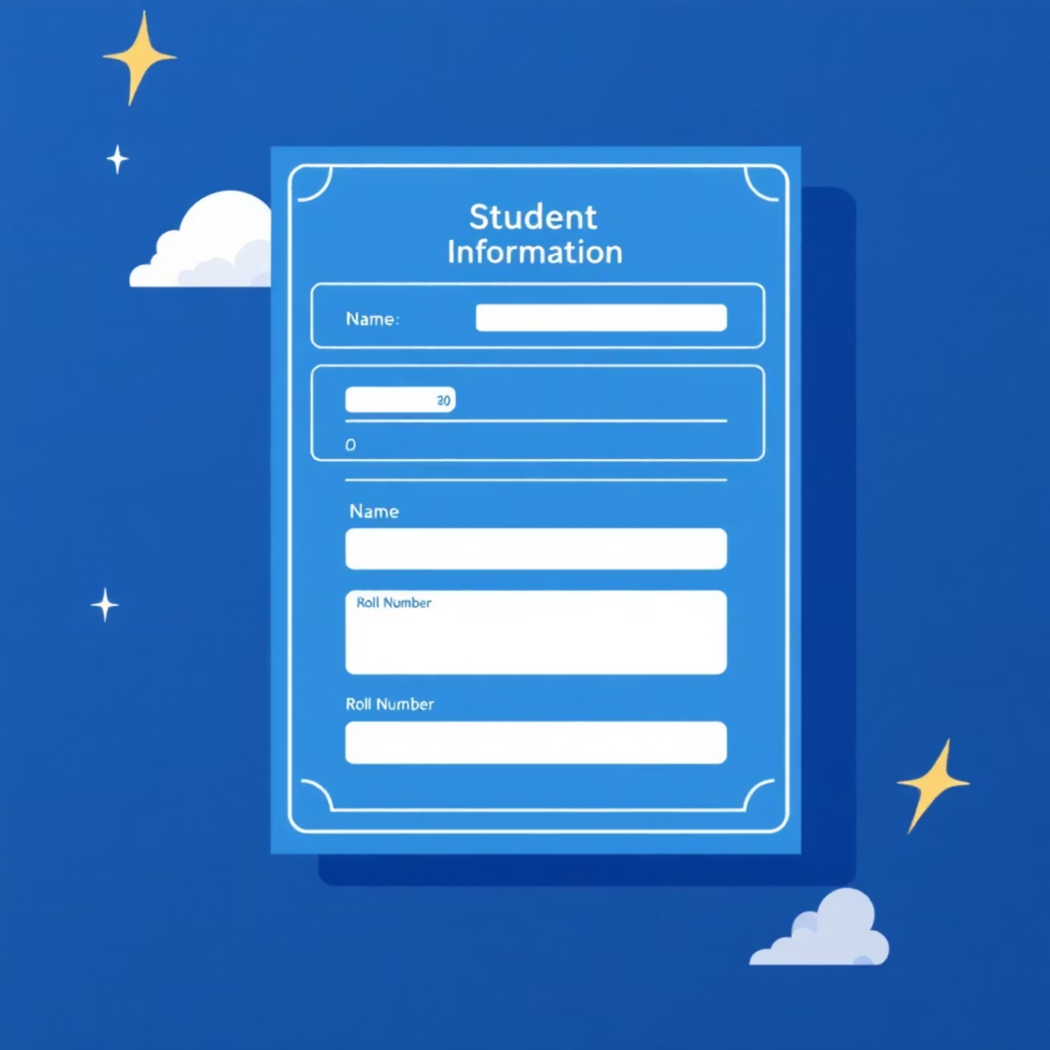



Key Features at a Glance
Accept Student Information
Efficient Mark Storage
Easily input student names and unique roll numbers for clear identification and record-keeping.
Securely store marks for three distinct subjects, providing a comprehensive view of academic performance.
Automated Calculations
User-Friendly Output
Total Marks: Sum of all subject scores.
Generates clear and easy-to-understand reports, making student performance accessible at a glance.
Average Marks: Mean score across all subjects.
Grade: Automatically assigned based on performance.

Slide 4




Core C++ Concepts Utilized
Classes & Objects
Access Specifiers
Loops
Fundamental building blocks for Object-Oriented Programming, enabling structured code and data encapsulation.
Using private and public to control data visibility and maintain data integrity within objects.
Efficiently iterate through subject marks for input and calculation of totals.
If-Else Conditions
Input/Output Operations
Implement branching logic for accurate grade evaluation based on average scores.
Utilizing cin and cout for seamless user interaction and displaying information.

Slide 5


Class Definition: The Student Blueprint
class Student { private: string name; int rollNo; int marks[3]; public: // Public methods will be defined here };
Secure Data Encapsulation
The Student class acts as a blueprint, holding student details such as name, roll number, and marks.
All data members are declared as private, ensuring secure access and preventing direct external modification.
This adheres to the principle of encapsulation, a cornerstone of Object-Oriented Programming.

Slide 6


The getData() Function: Inputting Information
void getData() { cout << "Enter student name: "; cin >> name; cout << "Enter roll number: "; cin >> rollNo; cout << "Enter marks for 3 subjects: "; for(int i = 0; i < 3; i++) { cin >> marks[i]; } }
Efficient Data Collection
The getData() function is responsible for gathering essential student information from the user.
It prompts for the student's name and roll number.
A for loop is used to efficiently read marks for each of the three subjects, streamlining the input process.

Slide 7
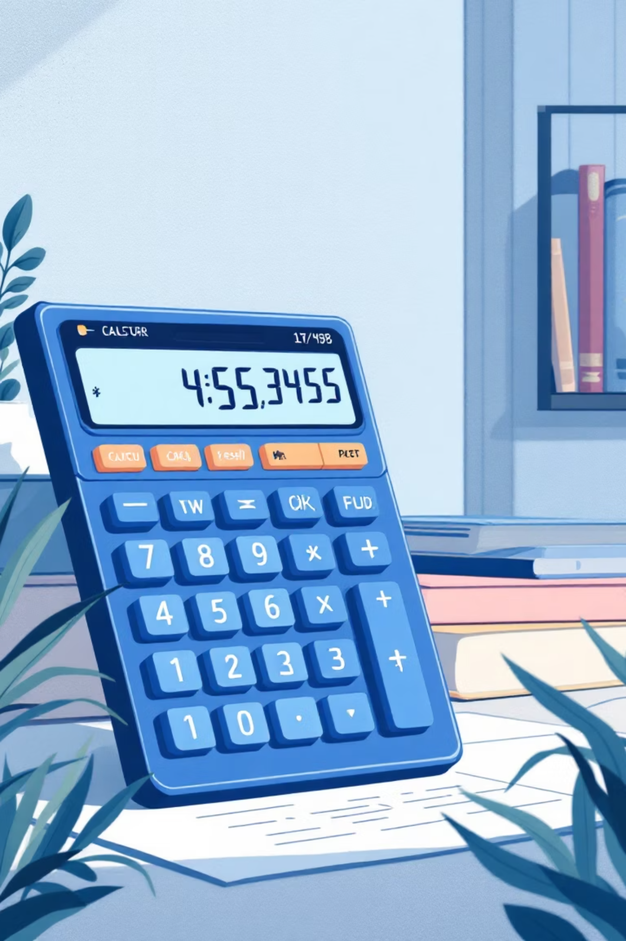

Report Generation: Displaying Results
Initialize Total
Starts with total = 0 to accumulate marks.
Sum Marks with Loop
A for loop iterates through the marks array, adding each subject's score to the total.
Calculate Average
average = total / 3.0 ensures floating-point division for precise results, providing the mean score.
Prepare for Grade Logic
With total and average computed, the system is ready to determine the student's final grade.
The displayReport() function orchestrates the calculation of a student's total and average marks, preparing the data for grade assignment and final presentation.

Slide 8
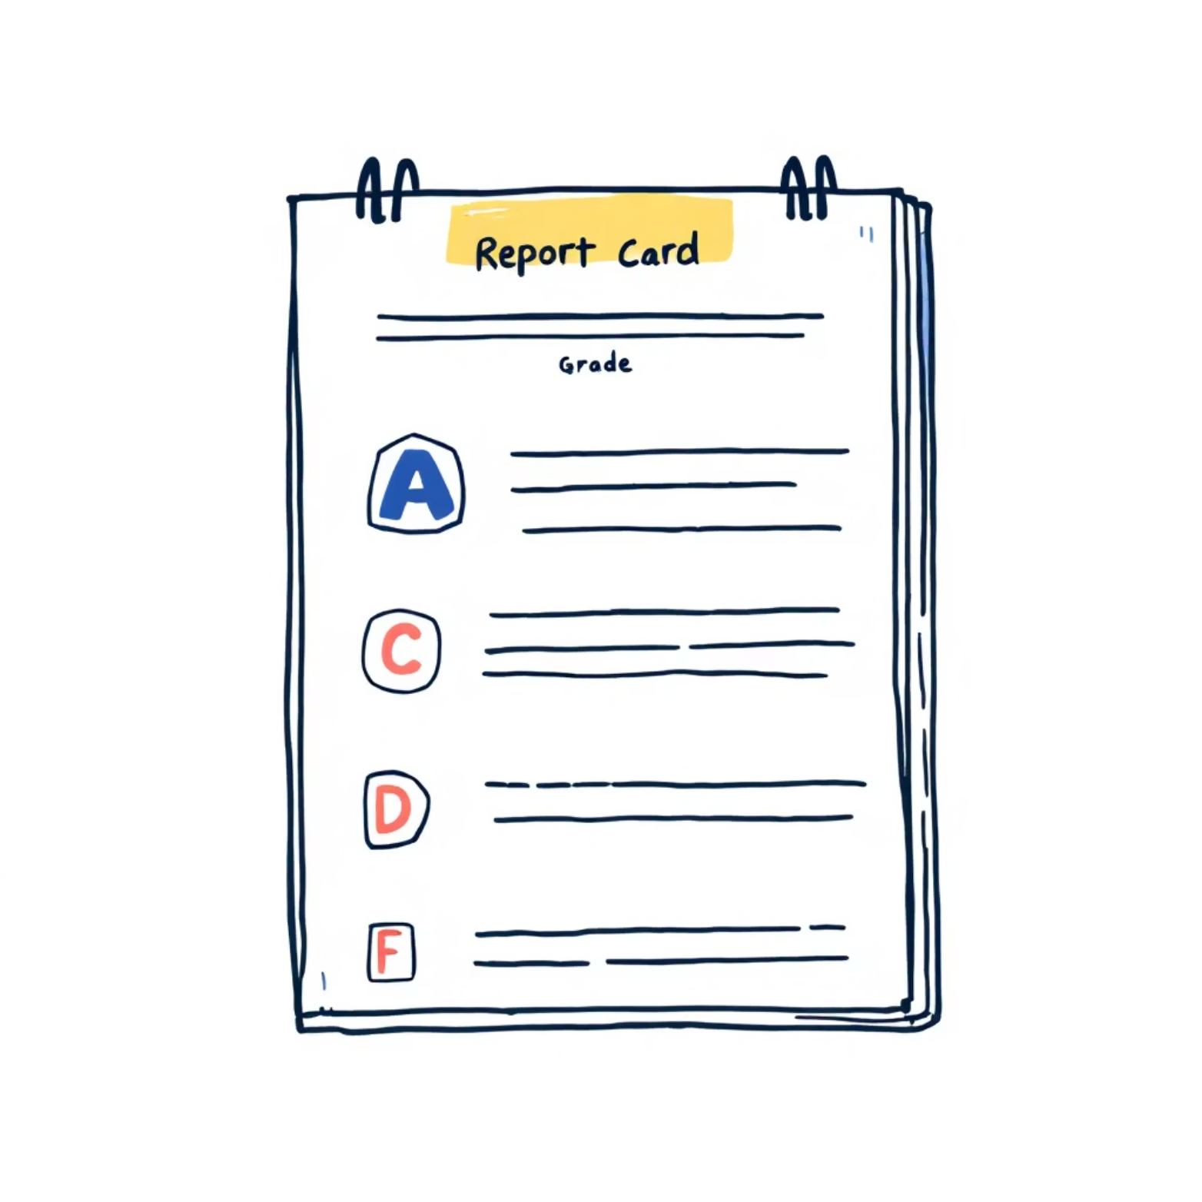

Grade Logic: Defining Academic Tiers
if (average >= 90) { cout << "A"; } else if (average >= 75) { cout << "B"; } else if (average >= 60) { cout << "C"; } else if (average >= 40) { cout << "D"; } else { cout << "Fail"; }
Conditional Grading System
This series of if-else if statements forms the core of the grading logic.
It systematically checks the calculated average score against predefined thresholds to assign a letter grade.
Grades range from 'A' for excellent performance (90% and above) to 'Fail' for scores below 40%, providing clear academic feedback.

Slide 9


Output Function: Presenting the Report
void displayReport() { // ... (calculations) ... cout << "\n------ Student Report ------\n"; cout << "Name: " << name << endl; cout << "Roll No: " << rollNo << endl; cout << "Total Marks: " << total << endl; cout << "Average: " << average << endl; cout << "Grade: "; // ... (grade logic) ... cout << endl; }
Clear & Concise Presentation
The displayReport() function concludes by neatly presenting all the gathered and calculated information.
It outputs the student's name, roll number, total marks, and calculated average.
This ensures that the final report is easy to read and provides a comprehensive overview of the student's performance.

Slide 10



Main Function & Future Enhancements
int main() { Student s; // 1. Object created s.getData(); // 2. Data input s.displayReport(); // 3. Report displayed return 0; }
Program Execution Flow
The main() function serves as the entry point, creating a Student object, invoking data input, and then displaying the final report.
Future Enhancements
Multiple Students: Extend to manage an array of student objects.
Data Persistence: Store and retrieve data using files for long-term retention.
Search & Update: Implement functionalities to find and modify student records.

Slide 11


Output: The Student Report Card
------ Student Report ------
Name: John
Roll: 10
Marks: 78 85 90
Total: 253
Average: 84.33
Grade: B

Slide 12


Thank You
We appreciate your time and attention to this presentation on the Student Report Management System.

